Slide 1
Generalized Dissimilarity Models
September 8, 2020

Slide 2
Quick Review: the Mantel Test
Purpose of the Mantel Test: examine the distribution of a species in terms of environmental variables that are assumed “operative constraints” on a species.
Why it’s important: Addresses two fundamental issues with environmental data: intercorrelation of physical explanatory variables (ie, soil moisture and vegetation density) and spatial autocorrelation (ie scale matters and may not be linear*).
Central Questions of the Mantel Test:
“Do samples that are similar in terms of predictor variables (environmental variables) also tend to be similar in terms of dependent species variable?”
Or, perhaps more simply: “Are sample sites that are close together also compositionally similar?”

Slide 3
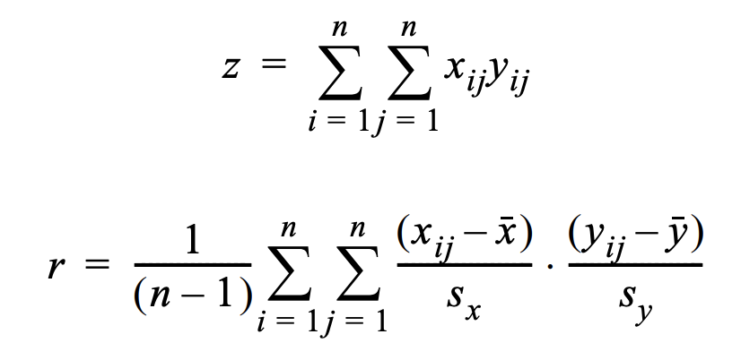
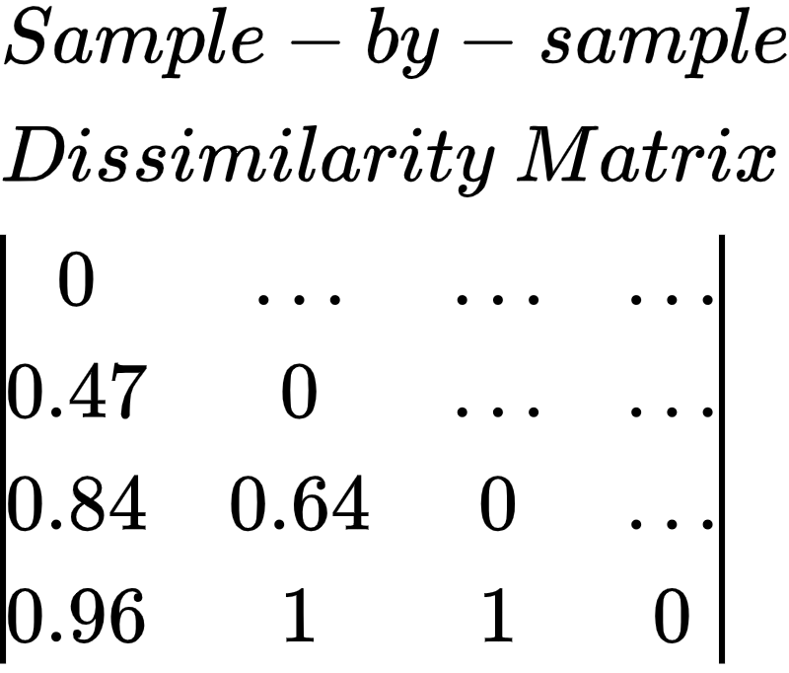
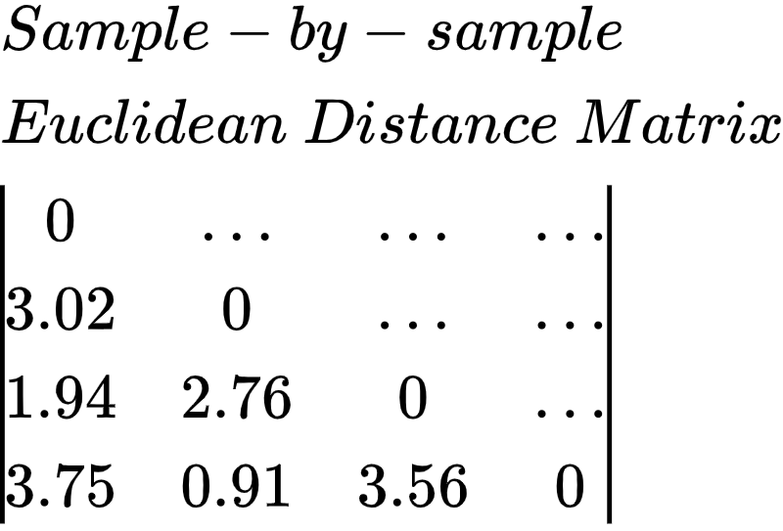
Quick Review: Mantel Test
How does it work? Matrix correlations.
Simple example:
Calculate z (non-normalized) and r (normalized) correlations and test for significance via permutation test

Slide 4
Limitations of the Mantel Test
Based on linear correlation, so nonlinear relationships (like spatial autocorrelation and distance decay) may have a degraded correlation (or, worst case scenario, no detectable correlation). In addition to linearity, Mantel Tests also assume homoscedasticity (which is a problem for spatial autocorrelation).
Rely on dissimilarity measures. Simulation studies consistently show that data analyses with raw data as opposed to dissimilarity indexes are more powerful statistically.
Originally developed for epidemiology to examine the relationship (dissimilarity) between two types of distances (temporal and spatial) between disease occurrences (ie truly independent distance measures). Careful applicability required for ecology.
Legendre P, Fortin M-J, Borcard D. Should the Mantel test be used in spatial analysis? Methods in Ecology and Evolution. 2015;6(11):1239-1247. doi:10.1111/2041-210X.12425

Slide 5
What does this have to do with GDM?

Slide 6
Mantel -> Matrix Regression -> GDM

Slide 7
Mantel -> Matrix Regression -> GDM
Mantel Test:
Calculate correlations (z or r) of dissimilarity and use permutation to test significance.
Generalized Dissimilarity Models:
‘Relaxation’ of linear assumptions to accommodate nonlinearity of two types:
Constraints of dissimilarity matrix (elements bounded 0, 1)** and so the relationship between ecological separation and observed compositional dissimilarity is “curvilinear”**
Rate of compositional turnover along environmental gradients may not be constant. (homoscedasticity)
Matrix Regression:
Reformulate the Mantel as linear regression, where “a single response matrix can be modelled as a function of distance matrices for any number of explanatory variables.”
Notes:
For example: Let A (our outcome matrix) be a matrix that contains compositional dissimilarities (beta diversity measures) between all possible pairs of survey sites in a given region. IE Let a_{ij} be the compositional dissimilarity between sites i and j.

Slide 8
Mantel -> Matrix Regression -> GDM
Mantel Test:
Calculate correlations (z or r) of dissimilarity and use permutation to test significance.
Generalized Dissimilarity Models:
‘Relaxation’ of linear assumptions to accommodate nonlinearity of two types:
Constraints of dissimilarity matrix (elements bounded 0, 1)** and so the relationship between ecological separation and observed compositional dissimilarity is “curvilinear”**
Rate of compositional turnover along environmental gradients may not be constant. (homoscedasticity)
Matrix Regression:
Reformulate the Mantel as linear regression, where “a single response matrix can be modelled as a function of distance matrices for any number of explanatory variables.”
Notes:
For example: Let A (our outcome matrix) be a matrix that contains compositional dissimilarities (beta diversity measures) between all possible pairs of survey sites in a given region. IE Let a_{ij} be the compositional dissimilarity between sites i and j.

Slide 9
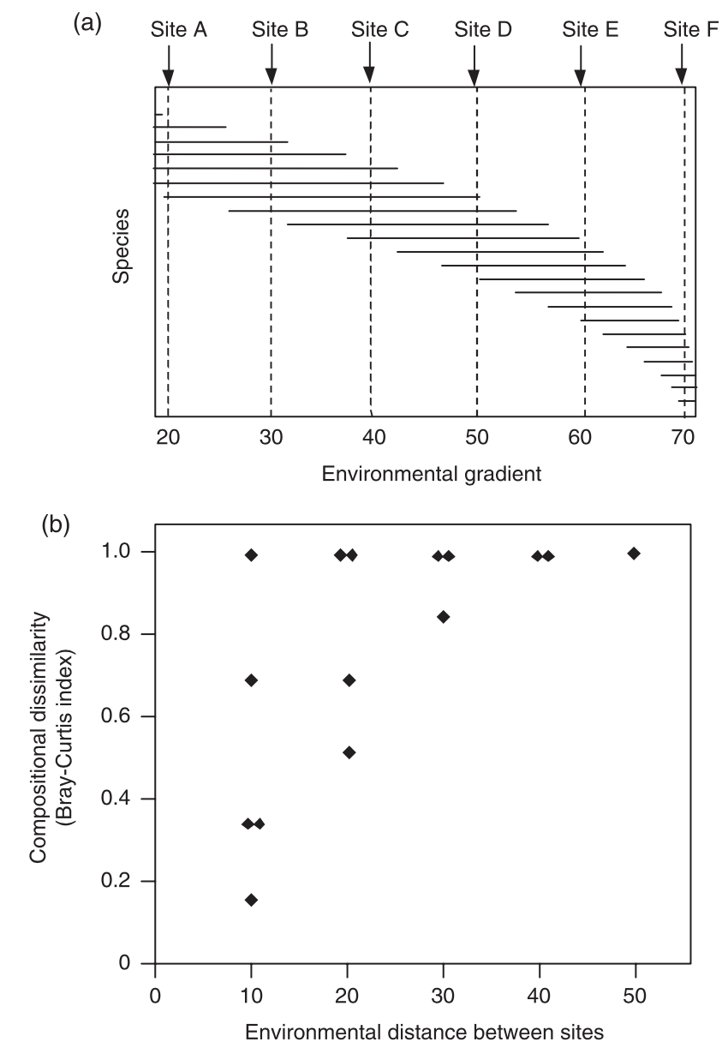
More detail:
Notice that site pairs A-B, B-C, C-D, D-E, and E-F all have the same level of separation when measured against the environmental gradient (10), but the rate of of dissimilarity increases left to right (curved). Hence, the second plot where site pairs at distance = 10, show considerable variation in compositional dissimilarity.
GDM provides us a method to accommodate these violated assumptions.

Slide 10
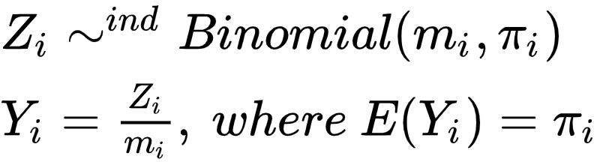
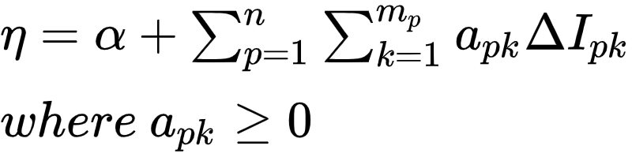
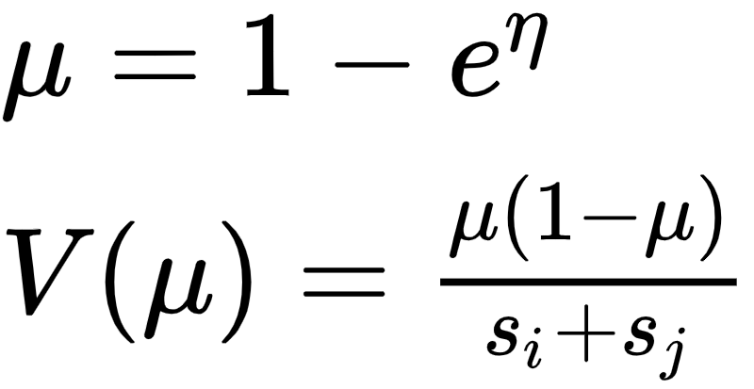
So how does GDM work?
Dissimilarity Constraint: Binomial GLM.
Random Component: Binomial Proportion
Systematic Component:
Link Component:

Slide 11

So how does GDM work?
Dissimilarity Constraint: Binomial GLM.
Random Component: Binomial Proportion
Systematic Component:
Link Component:
2. Linearity Assumption: use monotonic I-splines to fit nonlinear functions directly to the environmental variables as opposed to the derived pairwise distances.

Slide 12
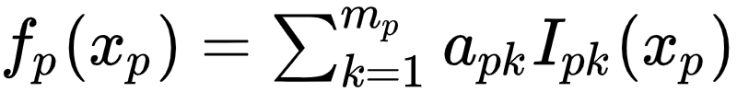
So how does GDM work?
Dissimilarity Constraint: Binomial GLM.
Random Component: Binomial Proportion
Systematic Component:
Link Component:
2. Linearity Assumption: use monotonic I-splines to fit nonlinear functions directly to the environmental variables as opposed to the derived pairwise distances.
Basic intuition: fitting a monotonically increasing spline (smoother) to the environmental variables, and then fit those as a linear combination of I-spline basis functions.

Slide 13
Well that’s great, but how do we do it...
Calculate compositional dissimilarity between all possible pairs of survey sites using and index (e.g. Bray-Curtis)
For each env. variable (x_{p}) derive a set of m_{p} I-spline basis functions and calculate the value at each survey site against each of these functions (I_{pk}(x_{p})).
For each of the values from 2, calculate the absolute difference in values between sites i and j (∂I_{pk})
For explicit distance variables (like geographical variables), do step 2.
Use MLE to fit coefficients (a_{pk}) using a non-negative least squares regression.

Slide 14
Well that’s great, but how do we do it...
Calculate compositional dissimilarity between all possible pairs of survey sites using and index (e.g. Bray-Curtis)
For each env. variable (x_{p}) derive a set of m_{p} I-spline basis functions and calculate the value at each survey site against each of these functions (I_{pk}(x_{p})).
For each of the values from 2, calculate the absolute difference in values between sites i and j (∂I_{pk})
For explicit distance variables (like geographical variables), do step 2.
Use MLE to fit coefficients (a_{pk}) using a non-negative least squares regression.
And then use R!
“gdm” Package

Slide 15
Why use a GDM?
And what can it tell us?

Slide 16
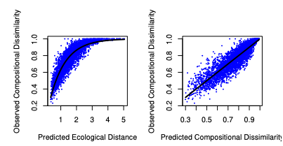
GDM Outputs: Model Fit
Example from data of 26 plant species from southwest Australia.
Can look at overall model fit, but also role of each explanatory environmental variable.
Appear to be able to use GLM assessment methods (deviance, AIC, to assess model fit)
(The combination of all predicted variables)
Strict linear relationship between fitted/observed

Slide 17
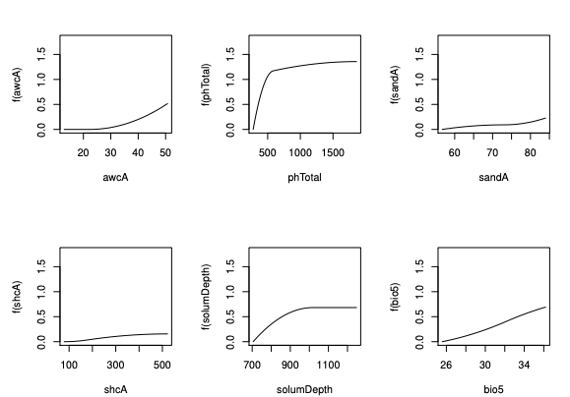
GDM Outputs: I-Splines
I-spline functions on y-axis, observed value range on x-axis.
The I-splines provide an indication of how species composition (or other biological measure) changes along each environmental gradient; so potentially provide valuable insight in physical processes.

Slide 18
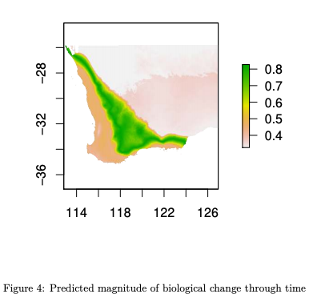
GDM Outputs: Prediction
GDM predict functions can also be used to estimate change across time under different scenarios. For example, one could model the magnitude of expected change in biological composition in response to environmental change. (Can use raster data too!)
Can also use in combination with PCA to predict communities of similarity across a landscape. (Figure not shown).

Slide 19
GDM: Other extensions
GDM can also support:
Nominal scaled predictors (e.g. habitat)
Extended measures of geographical separation (function of relative impedance, ie least cost distance)
phylogenetic/taxonomic information
Presence-only biological data**
GDM can be used for:
Extrapolating distributions of species or a priori community types
Survey gap analysis (directing new survey collection)
Conservation assessment
Climate change impact assessment

Slide 20
GDM: Important Limitations
Four very big constraints (in my opinion):
Severe danger of overfitting data (particularly small data) -> I-splines are smooth and flexible, if data is minimal or biased the GDM will have limited validity
Monotonicity assumption: GDMs assumes that dissimilarity increases over space measurements. This may not always be true.
Because proximate draws (close together sites with dissimilarity y_{i} and y_{j}) are still assumed independent (binomial proportion) there is a risk of overstating precision of coefficient estimates. (Interpret with care, maybe Bonferroni adjustment.)
Finally, there’s no direct implication of sampling scheme in GDMs, which may be problematic.

Slide 21
Additional Citations and Resources:
For a very helpful vignette on “how to”:
https://cran.r-project.org/web/packages/gdm/vignettes/gdmVignette.pdf
For general overview and synthesis:
Ferrier, Simon, Manion G., Elith, J., Richardson, K., “Using generalized dissimilarity modelling to analyse and predict patterns of beta diversity in regional biodiversity assessment.” Diversity and Distributions, 13, 252–264, 2007
Fitzpatrick MC, Sanders NJ, Normand S, Svenning J-C, Ferrier S, Gove AD, Dunn RR. 2013 Environmental and historical imprints on beta diversity: insights from variation in rates of species turnover along gradients. Proc R Soc B 280: 20131201. http://dx.doi.org/10.1098/rspb.2013.1201

Slide 22
R Tutorial

Slide 23
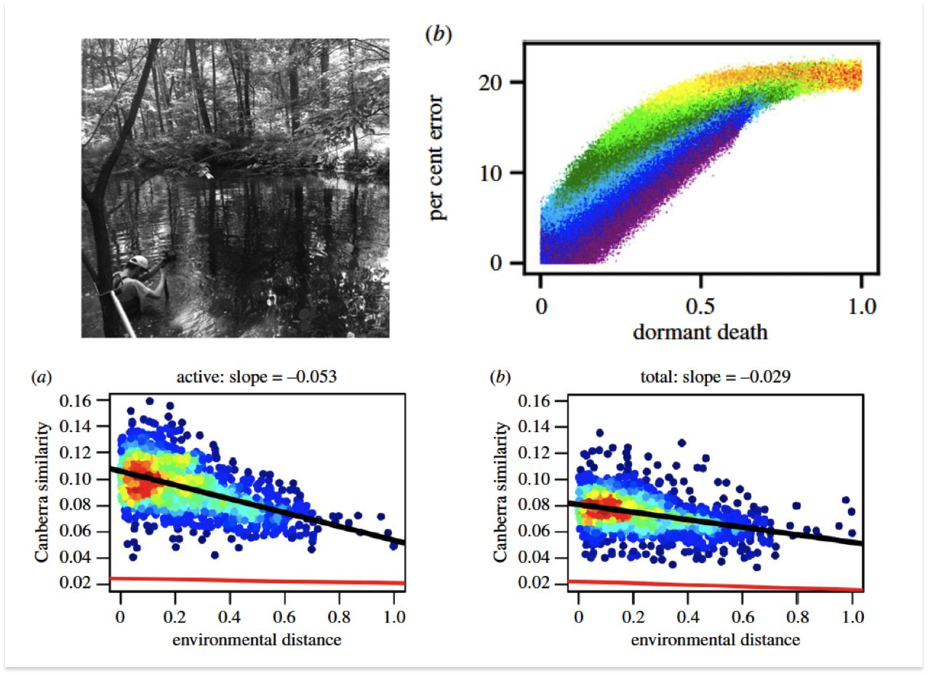
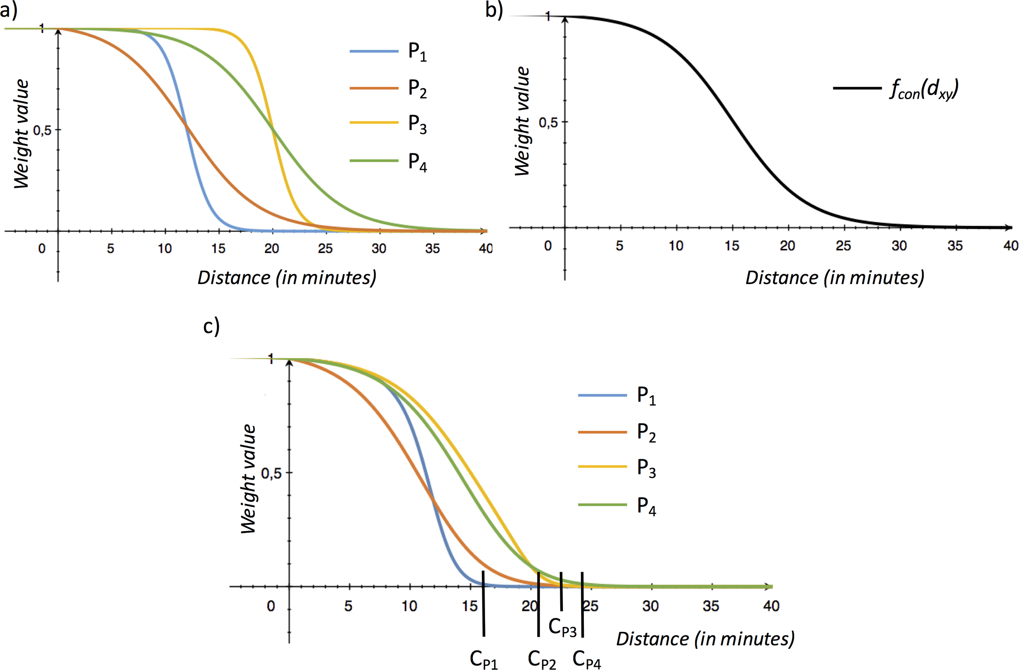
Quick Review: Mantel Test
“Dormancy dampens the microbial distance-decay relationship” (Jay T Lennon, Twitter)
“Everything is related to everything else, but near things are more related than distant things.” - Waldo Tobler, First Law of Geography

